Slide 1
LAN Connections
Exploring the Functions of Routing

Slide 2
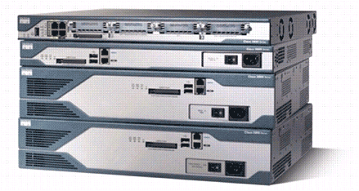
Routers
Cisco 2800 Series Router
  Routers have the following components:
    CPU
    Motherboard
    RAM
    ROM
  Routers have network adapters to which IP addresses are assigned.
  Routers may have the following two kinds of ports:
    Console: For the attachment of a terminal used for management
    Network: Different LAN or WAN media ports
  Routers forward packets based upon a routing table.

Slide 3
Router Functions
RouterX# show ip route
D 192.168.1.0/24 [90/25789217] via 10.1.1.1
R 192.168.2.0/24 [120/4] via 10.1.1.2
O 192.168.3.0/24 [110/229840] via 10.1.1.3
1
2
  Lets other routers know about changes
  Determines where to forward packets

Slide 4
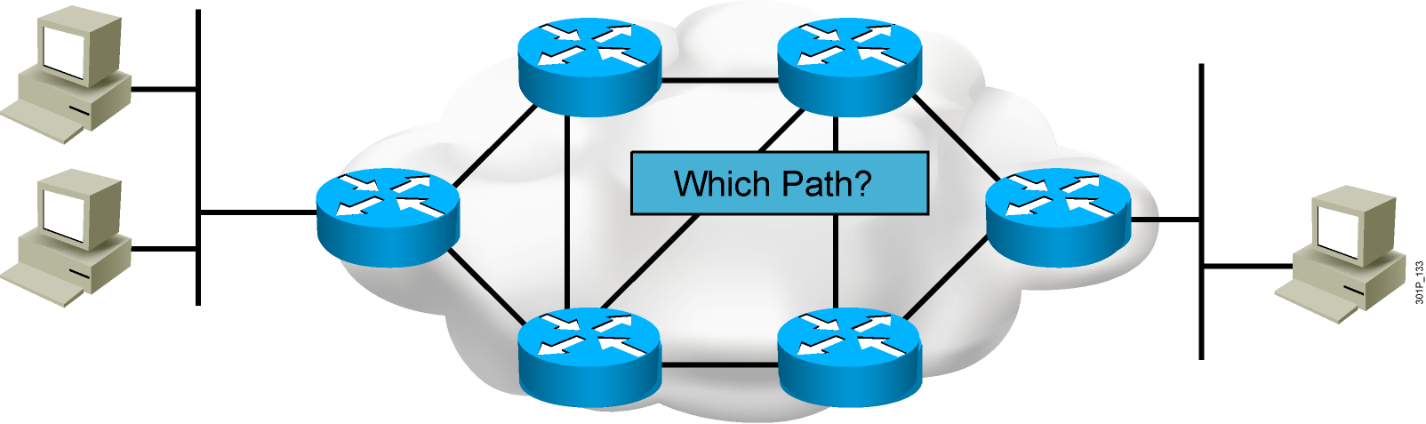
Path Determination

Slide 5
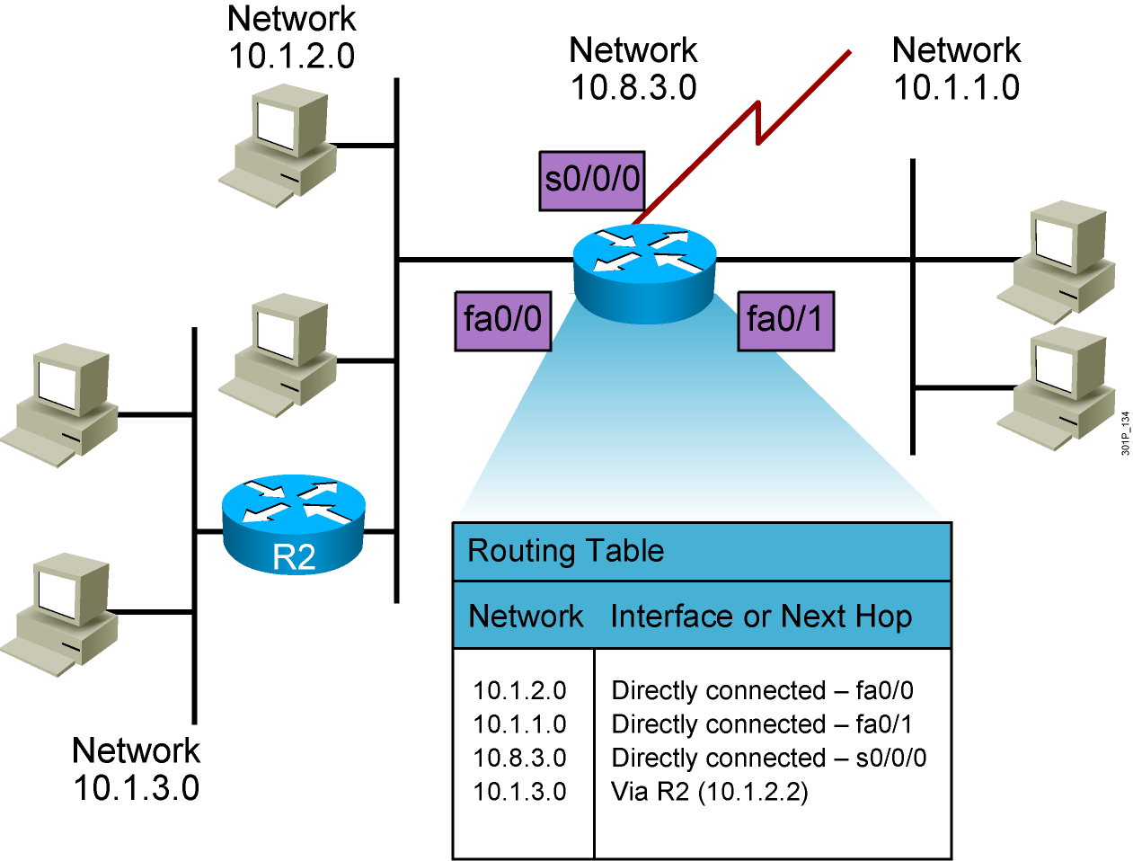
Routing Tables

Slide 6
Routing Table Entries
  Directly connected: Router attaches to this network
  Static routing: Entered manually by a system administrator
  Dynamic routing: Learned by exchange of routing information
  Default route: Statically or dynamically learned; used when no explicit route to network is known

Slide 7
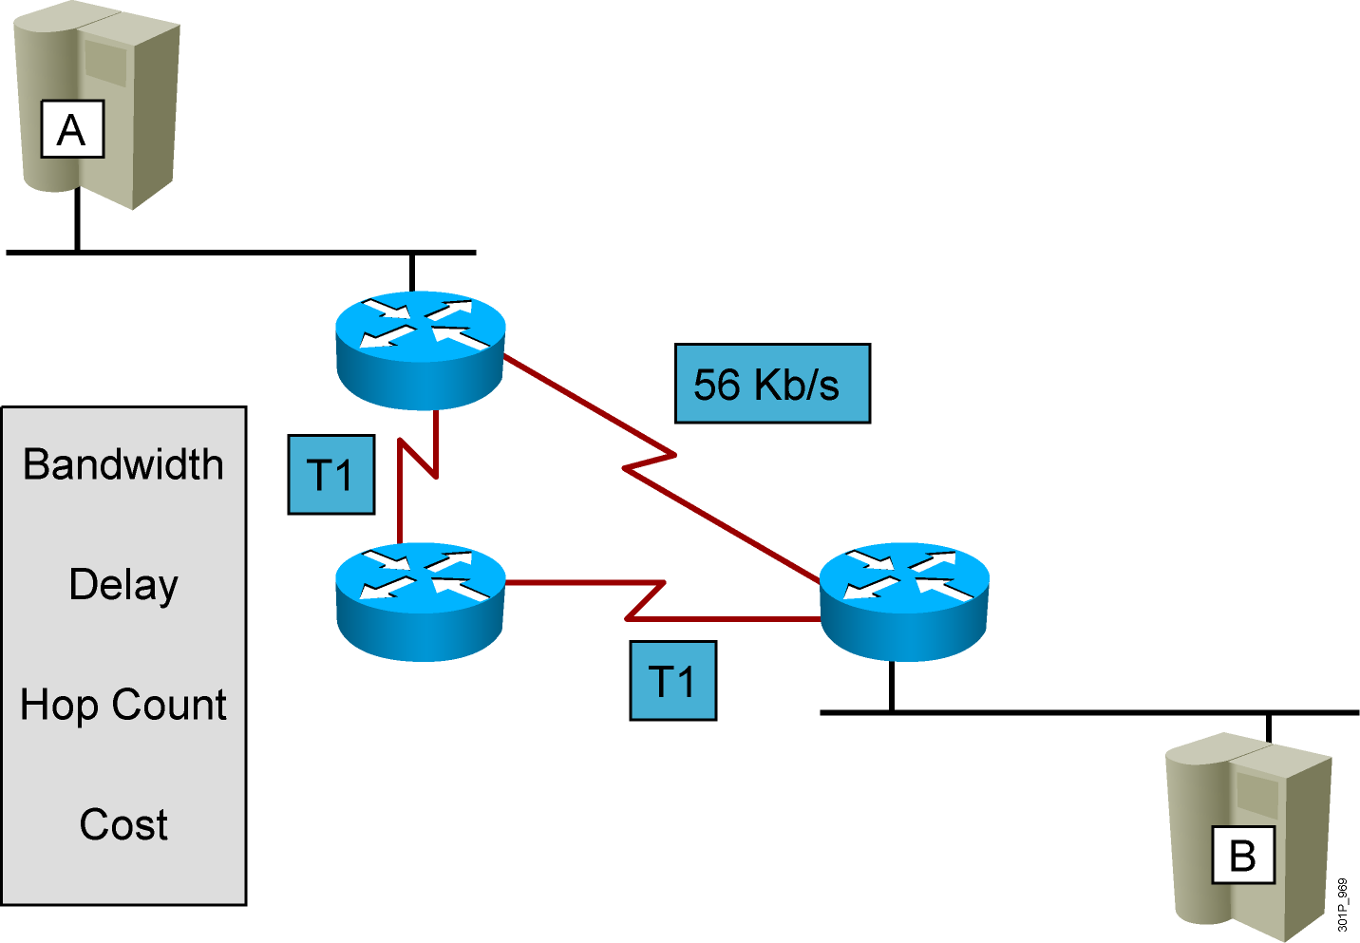
Routing Metrics

Slide 8
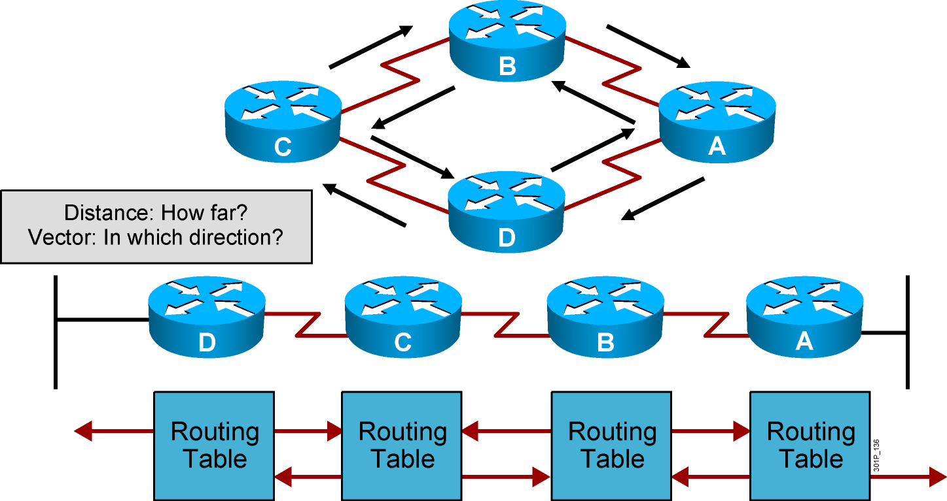
Distance Vector Routing Protocols
Passes periodic copies of routing table to neighbor routes and accumulates distance vectors
Notes:
Lesson Aim
<Enter lesson aim here.>

Slide 9
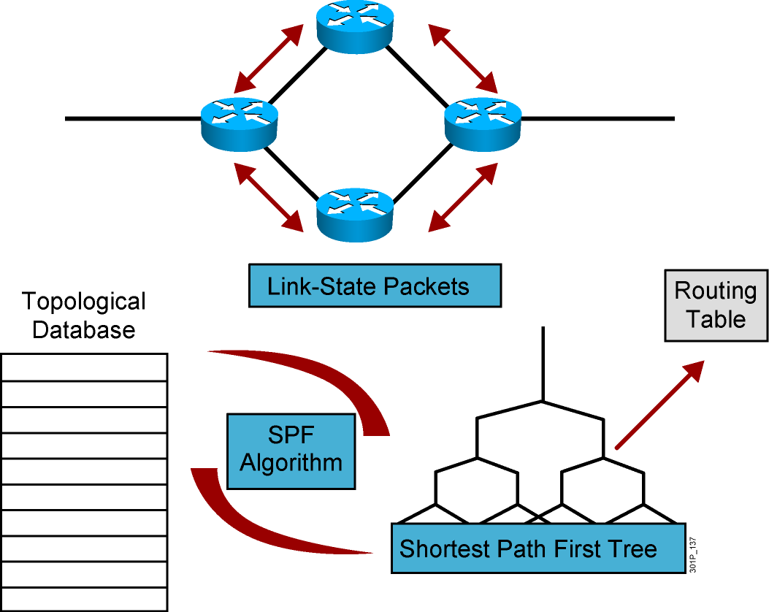
Link-State Routing Protocols
After initial flood, passes small event-triggered link-state updates to all other routers
Notes:
Lesson Aim
<Enter lesson aim here.>

Slide 10
Summary
  Routers have certain components that are also found in computers and switches, such as the CPU, motherboard, RAM, and ROM.
  Routers have two primary functions in the IP packet delivery process: maintaining routing tables and determining the best path to be used to forward packets.
  Routers determine the optimal path for forwarding IP packets between networks. Routers can use different types of routes to reach the destination networks, including static, dynamic, and default routes.
  Routing tables provide an ordered list of best paths to known networks, and include information such as destination, next-hop associations, and routing metrics.
  Routing algorithms process the received updates and populate the routing table with the best route.

Slide 11
Summary (Cont.)
  Commonly used routing metrics include bandwidth, delay, hop count, and cost.
  Distance vector routing protocols build and update routing tables automatically by sending all or some portion of their routing table to neighbors. The distance vector routing approach determines the direction (vector) and distance to any network in the internetwork.
  Link-state routing protocols build and update routing tables automatically, running algorithms against the link-state database to determine the best paths, and flood routing information about their own links to all the routers in the network.
  Cisco developed EIGRP, which combines the best features of the distance vector and link-state routing protocols.

